Slide 1
Image classification using transfer learning using rapid miner
Aiyshwarya Aruchamy

Slide 2
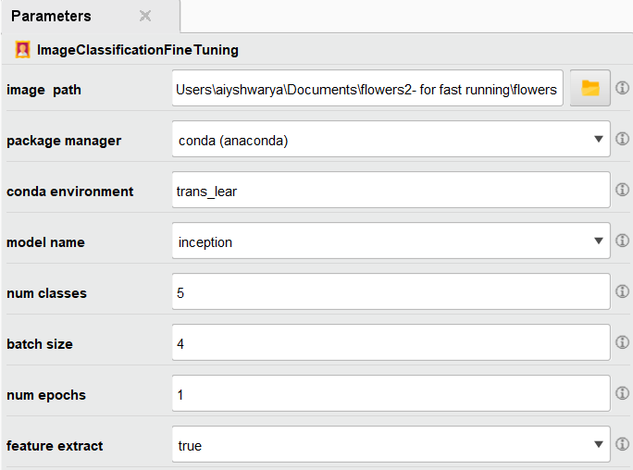
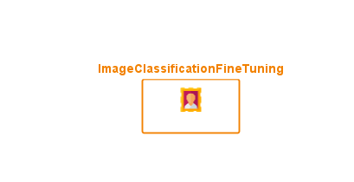
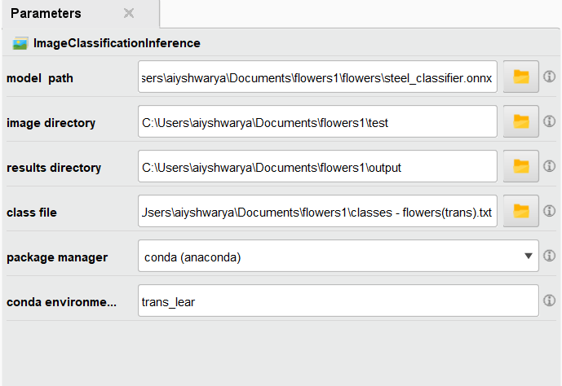
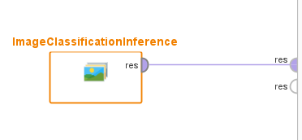
INTERFACE IN RAPIDMINER:
Image classification fine tuning Operator
Parameters for the Image classification fine tuning operator
Parameters for the Image Classification inference operators
Image classification inference operator

Slide 3
Data preparation
Model Initialization
data transformations to preprocess(resizing,cropping,converting to tensors,normalization)
pre-trained model is initialized based on the needed model name
Model Evalutation
Training Loop
After training the best -performing model is evaluated on the validation set
For each epoch training and validation is done . Training is done with backpropogation
NEED FOR NEW ARCHITECTURE
Model Saving
SINCE THIS ARCHITECURE WAS GIVING LOW ACCURACY ON INDUSTRIAL DATASETS IT WAS NECESSARY TO INCLUDE MORE COMPLEXITY
The best model is saved to a file and exported to onnx format

Slide 4
NEW ARCHITECTURE:
Data preparation
Model Initialization
More data augmentations added-, horizontal flipping, rotation, vertical flipping, and color jittering
Ensemble model is used by having multiple instances of the same model
Model Evalutation
After training the best -performing model is evaluated on the validation set
Training Loop
For the training set, a custom data loader is created using the ImbalancedDatasetSampler to handle class imbalance.Early stopping based on validation loss is used to prevent overfitting
Model Saving
The best model is saved to a file and exported to onnx format

Slide 5
COMPARISION OF ACCURACY:
DATASET | OLD MODEL | NEW MODEL
FLOWER CLASSIFICATION | 70-80% | 70-80%
STEEL DEFECT DATASET | 40-50-% | 60-70%
FUTURE WORK:
To generalize the model on industrial datasets.
The accuracy depends on the dataset*
To incorporate this new model architecture into Rapid Miner studio

Slide 6
INSTALLATION GUIDE:
This extension depends on following extensions which need to be installed before this one can be used:(install using marketplace)
- Custom Operators >= 1.1.0
- Python Scripting >= 10.0.1
You must be using the following Python versions and basic packages with the specified versions for this package:
-Numpy=1.23.2
-onnx=1.15.0
-onnxruntime=1.15.1
-opencv=4.9.0.80
-pandas=1.5.2
-pillow=10.2.0
-torch=2.1.0
-torchvision =0.16.0
-python=3.10.8
-Matplotlib
-Cv2
Using Conda in a command line shell, please create a new environment called “trans_lear”:
conda create -n trans_lear python=3.10.8 numpy=1.23.2 pandas=1.5.2 -c conda-forge
You will also need to install Pytorch, onnx, opencv and pillow.

Slide 7
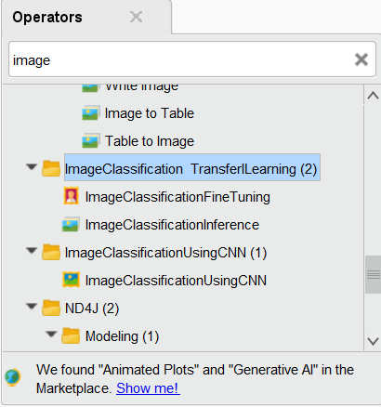
Place the provided .jar file inside .RapidMiner\extensions folder of the user directory and restart RapidMiner
Example,
C:\Users\user_name\.RapidMiner\extensions
https://altairengineering.sharepoint.com/:u:/s/DataAnalytics-APAC/EZQe-6Dk_XtFueyOBE8PHV0Bv2ZPuK4NwP3nOdIai-xqug?e=qAW7AG
After the required dependencies are installed & .jar files are placed correctly, you can see the extension inside Extension folder of Operators pane in RapidMiner Studio like this:

Slide 8

DEMO VIDEO OF HOW TO USE THE EXTENSION:

Slide 9
THANK YOU

